Slide 1


Design and Implementation of a RISC-V Based SoC Subsystem with AXI Interconnect for Embedded Application
RISC-V ISA (Open-source, Royalty-free)
AXI4-Lite VALID/READY handshake.
OpenLane RTL-to-GDSII flow, SkyWater 130nm PDK
Ensures reliable master-slave communication.

Slide 2











Agenda
01
04
RISC-V ISA Fundamentals
Physical Design Flow
Overview of RISC-V architecture, its open-source model, and comparison with ARM and x86 ISAs.
Step-by-step RTL-to-GDSII flow using OpenLane toolchain and SkyWater 130nm open-source PDK.
02
05
SoC System Architecture
Verification & Results
Introduction to the PicoRV32 core, AXI4-Lite interconnect fabric, SRAM, and UART peripheral integration.
Design rule checks, LVS verification, synthesis results, and final GDSII layout evaluation.
03
06
RTL Implementation Details
Conclusions & Future Work
Deep dive into AXI4-Lite handshake signals, UART protocol framing, and Verilog module design.
Summary of key findings and potential extensions for the RISC-V SoC subsystem design.

Slide 3

What is RISC-V? (Reduced Instruction Set Computer – V)
RISC-V is a free, open-source Instruction Set Architecture (ISA) — it defines the set of instructions a processor must understand, without requiring any license fees or proprietary restrictions.
Open & Royalty-Free ISA
RISC Philosophy
Anyone can design a RISC-V chip without royalties. Ideal for custom silicon, academic research, and ulike licensed or proprietary ISAs like ARM or Intel. Used by companies like Google, SiFive, Western Digital.
Simple, fixed-length instructions enable efficient pipelining. Focuses on instructions-per-cycle (IPC) to lower hardware complexity and power consumption.
Modular Architecture
PicoRV32 Implementation
Modular architecture: mandatory base plus optional extensions. Enables tailoring to specific application needs.
This SoC implements PicoRV32 core with RV32IMC configuration. Adds multiply/divide (M) and compressed (C) instruction extensions. Optimized for minimal area.

Slide 4
SoC Subsystem Architecture
This SoC Subsystem integrates the PicoRV32 CPU with an AXI4-Lite interconnect fabric, ROM, SRAM, and UART into a single cohesive unit for embedded applications.
PicoRV32 AXI Master
AXI4-Lite Interconnect
Address Mapping
• The 'picoRV32_axi' variant features a standard AXI4-Lite master interface. • CPU directly initiates read/write transactions across the fabric.
• A lightweight bus fabric efficiently routes transactions. • Performs address decoding to simplify control and data register access.
• ROM, 2KB SRAM, and UART are memory-mapped to unique address ranges. • Simplifies uniform access via standard AXI4-Lite operations.
VALID/READY Handshake
Core Peripherals
Modular Design
• Uses the VALID/READY signals across all AXI channels. • Ensures master and slave are synchronized before any data transfer occurs.
• Integrated modules include Boot ROM, 2KB SRAM, and UART for essential services. • Provides program storage, data memory, and external communication.
• Address-mapped architecture allows easy addition of new peripherals. • New AXI4-Lite slaves or accelerators integrated without core modifications.

Slide 5
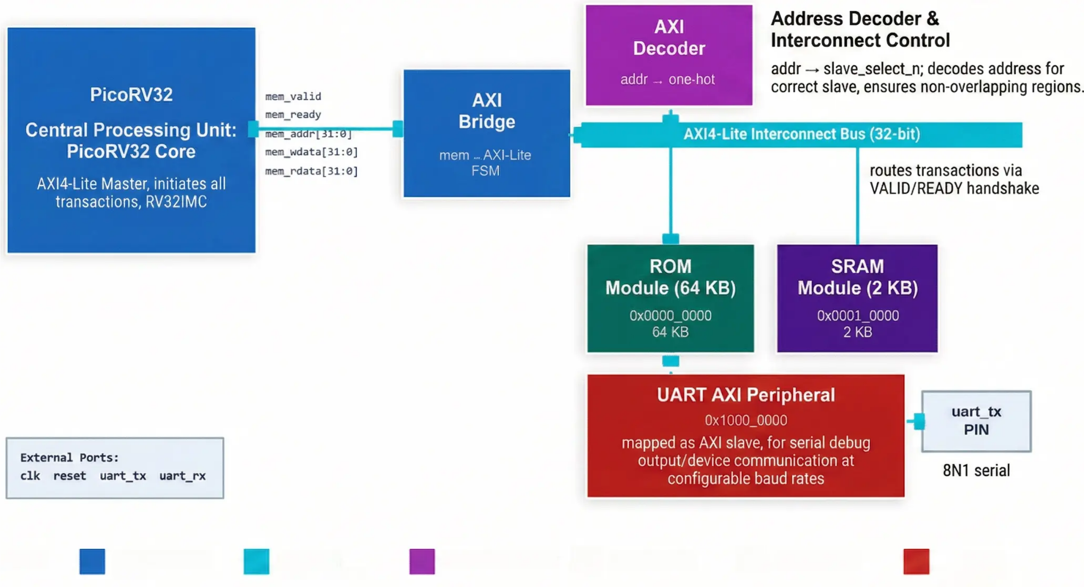




System Block Diagram
Legend:
PicoRV32 CPU Core
AXI4-Lite Interconnect
Address Decoder
ROM (64 KB)
SRAM (2 KB)
UART AXI Peripheral

Slide 6
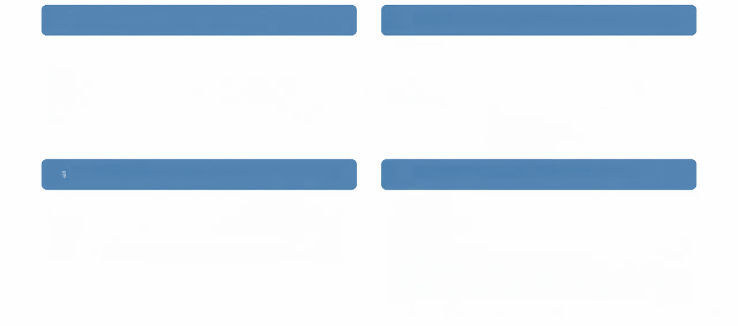


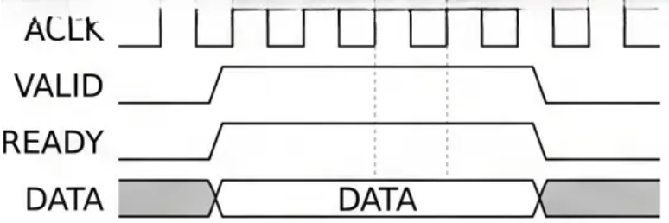

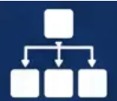
PART 1: HANDSHAKE & RTL IMPLEMENTATION
RTL DESIGN OVERVIEW
AXI-LITE HANDSHAKE PROTOCOL
• Detailed Verilog implementation of PicoRV32 core, AXI interconnect, SRAM, and UART modules. • Synthesis-friendly and optimized RTL code.
• Data transfers only when both VALID and READY are asserted high. • Source-destination synchronization mechanism.
PicoRV32 AXI MASTER INTERFACE
COMPONENT RTL STRUCTURE
• Utilizes 'picorv32_axi' variant with a native AXI4-Lite master port. • Direct connection to interconnect without bridges.
• SRAM and UART peripherals implement AXI- Lite slave interfaces. • Interconnect routes transactions based on address decoding. • Monospace signals like AWVALID, AWREADY, WVALID, WREADY, BVALID, BREADY used in Courier New font.

Slide 7

Core Compoment Overview
• PicoRV32 Core: Role & Configuration - A size-optimized RV32IMC CPU core; configurable as RV32I/IM/IMC; the picoRV32_axi variant exposes an AXI4-Lite master interface for SoC integration.
• PicoRV32 Key RTL Signals - Primary signals include mem_valid, mem_ready, mem_addr, mem_wdata, mem_rdata, and mem_wstrb, forming the native memory interface before AXI bridging.
• AXI Bridge: Adapting Core to Fabric - The AXI bridge wraps PicoRV32 native signals into standard AXI4-Lite channels, translating mem_valid/mem_ready handshakes into AVALID, WVALID, ARVALID, and response signals.
• AXI4-Lite Interconnect Signals - Five channels operate via VALID/READY handshake: Write Address (AWVALID/AWREADY), Write Data (WVALID/WREADY), Write Response (BVALID/BREADY), and Read Address/Data equivalents.
• SRAM Peripheral Module - A 2KB SRAM serves as instruction and data storage; it acts as an AXI4- Lite slave, responding to read/write transactions from the processor via the interconnect fabric.
• UART Peripheral Module - The UART module is an AXI4-Lite slave exposing control/status registers; it converts parallel bus data into asynchronous serial frames for external debug and communication.

Slide 8

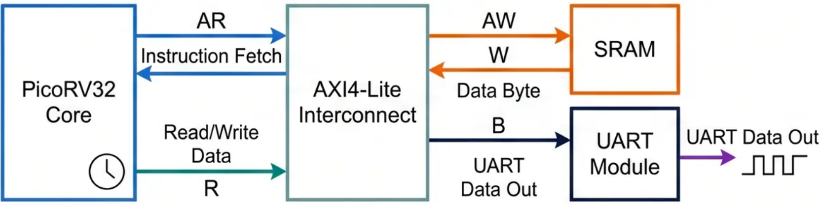
System-Level Data Flow
Boot & Instruction Fetch
Address Decode by Interconnect
1
4
At power-on, PicoRV32 core is reset and drives a read address onto the AXI Read Address (m_axi_araddr) channel, asserting ARVALID ARVALID to fetch the first instruction from SRAM (mapped memory).
The central AXI4-Lite interconnect inspects the generated transaction address. It decodes the address to route the transaction to the correct slave device: SRAM for data memory or UART for serial output.
AXI Handshake & Data Return
Peripheral Write via UART
2
SRAM asserts ARREADY to complete the read address handshake. It then returns the fetched instruction data (m_axi_rdata) on the Read Data channel. The transfer completes when both RVALID and RREADY are high.
5
For a UART transmission, the core asserts AWVALID with the UART base address (m_axi_awaddr) and WVALID with the data payload (m_axi_wdata). The UART module accepts the data.
Decode & Execute in Core
Write Response & Next Cycle
3
PicoRV32 decodes the received RV32IMC instruction internally. It then performs the specified ALU operation or generates a new bus address for a subsequent memory or peripheral access.
6
The UART module frames the data and transmits it. It returns a write response on the AXI channel, asserting BVALID, BREADY with an 'OKAY' response. The core asserts 'BREADY', then loops back to fetch the next instruction.

Slide 9

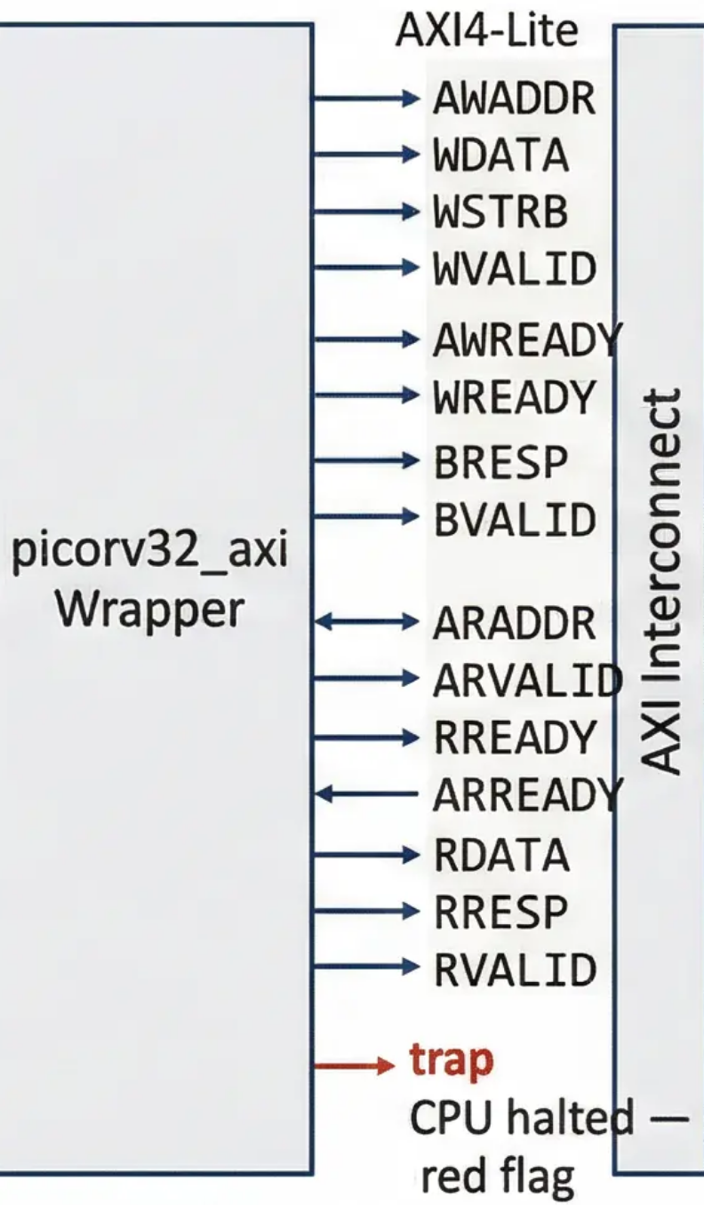
PicoRV32 CPU Architecture
ENABLE_MUL=1 ENABLE_COMPRESSED=1
Key Features & Configuration
AXI Integration
• RV32IMC Instruction Set Support: Implements full RV32IMC for integer, multiply, and compressed instructions for efficient embedded use.
INPUTS
OUTPUTS
PicoRV32 CPU Core
clk
mem_valid
Clock
Instruction Decoder (RV32IMC Support)
Request active
• Size-Optimized 32-bit Core: Designed for minimal footprint, configurable as RV32E, I, IM, or IMC.
resetn
mem_addr [31:0]
Low reset
ALU (Integer & Multiplier)
Target address
mem_wdata [31:0]
• Configurable Core Parameters: Enable or disable hardware 32 interrupt
Lines multi/compressed via top-level Verilog parameters.
Register File (x0-x31, Configurable)
Data to write
irq [31:0]
mem_wstrb [3:0]
mem_ready
Memory Controller (Native Interface)
Byte enables
Memory
handshake
eoi [31:0]
Memory Interface
End of interrupt
IRQ Handler (Up to 32 interrupts)
Simple mem_valid/mem_ready from
Memory handshake for native transactions. Sole AXI Master initiating reads/writes to SRAM & UART.
mem_
rdata
[31:0]
trap
CPU halted — red flag

Slide 10
Address Decoder — axi_decoder.v
// axi_decoder.v — casez address matching
Address Map
always @(*) begin
Base Addr
Slave
sel[2:0]
Actual Size
casez (addr)
0x0000_0000
ROM
001
8KB (2048w)
32'h0000_????: begin
sel = 3'b001; // ROM
0x0001_0000
SRAM
010
256B (64w)
end
32'h0001_????: begin
0x1000_0000
UART
100
3 registers
sel = 3'b010; // SRAM
end
⚠ Important Distinction
32'h1000_000?: begin
64KB address WINDOW ≠ physical memory size.
• ROM window = 64KB, actual depth = 8KB
• SRAM window = 64KB, actual depth = 256B
• UART: only 3 × 32-bit registers exist
sel = 3'b100; // UART
end
default: sel = 3'b001; // ROM (safe)
endcase
casez uses '?' as wildcard — matches any nibble → covers full 64KB windows
end

Slide 11
SRAM Module — sram.v
SRAM Module — Key Parameters & Behaviour
Depth
64 words
// Write with byte enable (sram.v)
always @(posedge clk) begin
Width
32 bits (4 bytes)
if (we && valid) begin
if (wstrb[0]) mem[addr][7:0] <= wdata[7:0];
Physical Size
64 × 4 = 256 Bytes
if (wstrb[1]) mem[addr][15:8] <= wdata[15:8];
if (wstrb[2]) mem[addr][23:16] <= wdata[23:16];
Address Window
0x0001_0000 – 0x0001_FFFF (64KB)
if (wstrb[3]) mem[addr][31:24] <= wdata[31:24];
end
Stack Top
0x0001_00FC
end
ASIC-Clean
No initial block — reset-driven
// Read (combinational)
assign rdata = mem[addr];
✓ Reset-driven init (all zeros via reset loop) — NO 'initial begin' block — fully ASIC-clean

Slide 12
Native Memory Interface & AXI Bridge Signals
PicoRV32 CPU Core (RV32I)
Config
Native
Memory I/F
Fetch Unit
Decode
Execute / ALU
Register File
ENABLE_MUL
0
ENABLE_DIV
0
mem_valid
PC=0x0_0000
mem_instr=1
32-bit opcode
RV32I only
ALU + shift
TWO_STAGE=0
x0–x31
32×32-bit
mem_instr
COMPR_ISA
0
mem_ready
mem_addr
ENABLE_IRQ
0
mem_wdata
COUNTERS
1
mem_wstrb
mem_rdata
CATCH_ILL
1
Key Interface Signals — PicoRV32 ↔ AXI Bridge FSM
mem_valid
1 = CPU has valid address/data
mem_ready
1 = memory accepted request
mem_instr
1 = instruction fetch (not data)
mem_addr[31:0]
Target address (ROM/SRAM/UART)
mem_wstrb[3:0]
Byte-enable: 0=read, 1111=32b write
mem_rdata[31:0]
Read data returned to CPU

Slide 13
RTL Signals Deep-Dive — AXI4-Lite Channel Signals
AW — Write Address
W — Write Data
B — Write Response
awvalid
Master: valid write address
wvalid
Master: valid write data
bvalid
Slave: write complete
awready
Slave: ready to accept
wready
Slave: ready to accept data
bready
Master: accepts response
awaddr[31:0]
Write target address
wdata[31:0]
Write data
bresp[1:0]
2'b00 = OKAY
awprot[2:0]
Protection type (ignored)
wstrb[3:0]
Byte enable strobe
-
-
AR — Read Address
R — Read Data
arvalid
Master: valid read address
rvalid
Slave: valid read data
arready
Slave: ready to accept
rready
Master: accepts data
araddr[31:0]
Read target address
rdata[31:0]
Read data from slave
arprot[2:0]
Protection (ignored)
rresp[1:0]
2'b00 = OKAY
Handshake rule: transfer occurs when BOTH valid AND ready are HIGH in the same clock cycle

Slide 14
AXI4-Lite Handshake Protocol — Timing & Rules
Core Handshake Rules
Bridge FSM — 5 States (top.v L91–224)
Transfer occurs ONLY when valid=1 AND ready=1 simultaneously
ST_IDLE
Wait for mem_valid from CPU. Check mem_wstrb to route write vs read.
Master asserts valid and HOLDS it until ready goes high
ST_WR_AW
Assert awvalid. Wait for awready from interconnect.
Slave may assert ready before or after valid — both are legal
Master must NOT deassert valid once asserted (until handshake)
ST_WR_B
Assert wvalid. Collect bresp. Assert mem_ready to CPU.
Write requires 2 handshakes: AW+W channels (may be concurrent)
ST_RD_AR
Assert arvalid. Wait for arready from interconnect.
Write response B-channel must be accepted by master (bready=1)
ST_RD_R
Wait for rvalid. Capture rdata. Assert mem_ready to CPU.
Read uses 2 handshakes: AR channel then R channel (sequential)
Write path: ST_IDLE → ST_WR_AW → ST_WR_B → ST_IDLE | Read path: ST_IDLE → ST_RD_AR → ST_RD_R → ST_IDLE

Slide 15
AXI-Lite Bus Protocol — How the CPU Talks to Peripherals
AXI (Advanced eXtensible Interface) is ARM's AMBA bus standard. AXI-Lite is the simplified version — fixed 32-bit data width, no bursts. Used here to connect the CPU to ROM, SRAM, and UART.
AW Write Address | W Write Data | B Write Response | AR Read Address | R Read Data
Master sends: AWADDR (32-bit), AWVALID Slave responds: AWREADY → Tells slave WHERE to write | Master sends: WDATA (32-bit), WSTRB (4-bit byte enables), WVALID Slave responds: WREADY → Sends the DATA to write | Slave sends: BRESP (2-bit: 00=OK), BVALID Master responds: BREADY → Confirms write completed | Master sends: ARADDR (32-bit), ARVALID Slave responds: ARREADY → Tells slave WHERE to read from | Slave sends: RDATA (32-bit), RRESP, RVALID Master responds: RREADY → Slave returns the READ data

Slide 16
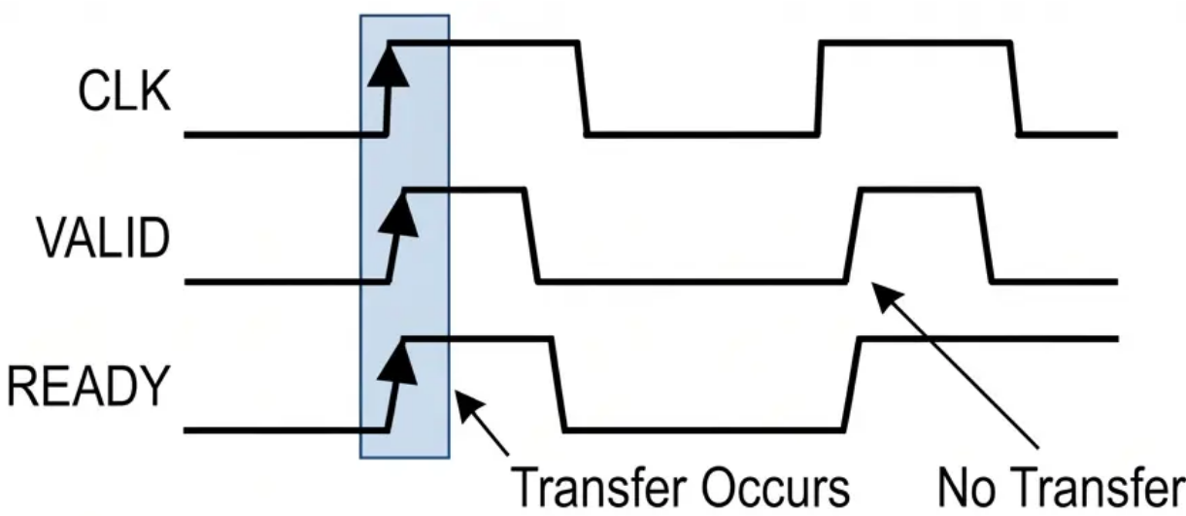
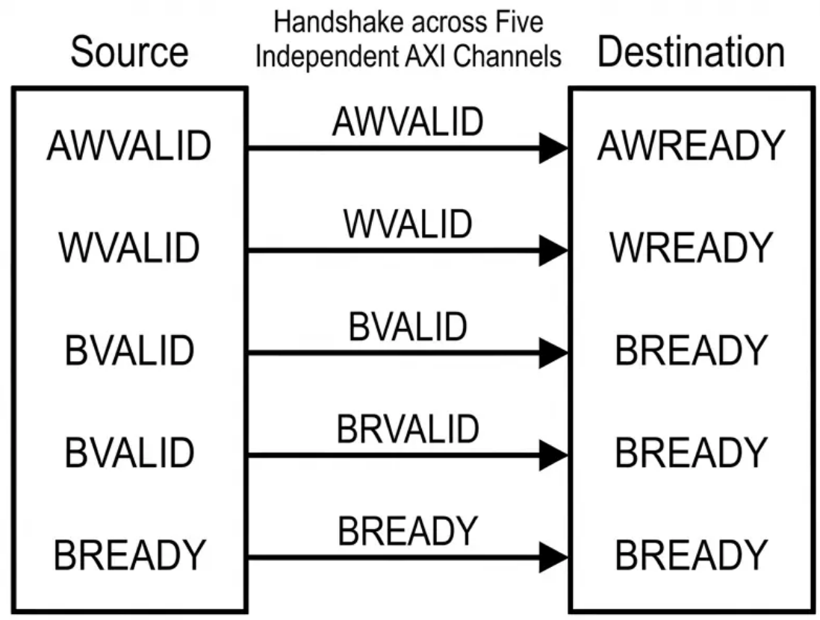
AXI VALID/READY Handshake
1
Handshake Occurs: Both VALID and READY must be HIGH at rising clock edge.
2
VALID Behavior: Source must hold VALID high until handshake completes. Cannot deassert before READY.
3
READY Behavior: Destination asserts to indicate it can accept data. May assert before or after VALID.
4
Five Independent Channels: Applies separately for Write Address, Write Data, Write Response, Read Address, and Read Data.
5
Deadlock Prevention: Rules prohibit VALID from waiting for READY, preventing circular dependency deadlocks.
6
Handshake Types: Governs individual channel transactions (Address, Data, Response), each completing independently.

Slide 17







UART Communication Module
UART is a serial communication protocol. Data is sent one bit at a time over a single wire (TX or RX), with no shared clock — both sides must agree on the baud rate in advance.
8N1 Frame Format (8 data bits, No parity, 1 stop bit)
START
D0
D1
D2
D3
D4
D5
D6
D7
STOP
Always 0
Always 1
LSB first
MSB
Baud Rate | TX (Transmit)
Bits per second. Both sides must match. This project: 115,200 baud @ 50 MHz clock. CLKS_PER_BIT = 50,000,000 / 115,200 = 434 | PicoRV32 writes byte to UART AXI register. uart_tx.v shifts it out serially: START → D0..D7 → STOP
RX (Receive) | AXI-Lite Interface
uart_rx samples incoming bit stream. Detects START bit, then clocks in 8 data bits. Outputs valid byte when STOP received. | CPU writes to 0x10000000 (UART TX reg). uart_axi.v bridges AXI bus to uart_tx. CPU can poll ready flag to know when done.

Slide 18
Firmware / Software Stack — fw/main.c
fw/ directory
Linker Memory Map
// fw/main.c (key macros)
fw/
#define UART_TX \
ROM (text)
0x0000_0000
8KB
├── main.c
(*((volatile uint32_t*)\
SRAM (data)
0x0001_0000
256B
0x10000000))
├── start.S
├── link.ld
Stack
0x0001_00FC
↓ grows down
void uart_putc(char c) {
UART_TX = c;
├── firmware.bin
UART TX
0x1000_0000
—
}
└── rom.hex ← output
UART RX
0x1000_0004
—
void main() {
uart_puts(
UART STATUS
0x1000_0008
—
"Hello Deepak\n");
echo_loop();
}
Build flow: gcc → firmware.elf → objcopy → firmware.bin → bin2hex → rom.hex | make fw runs all steps automatically

Slide 19
Simulation — Verilator Flow
make fw
make soc
./sim_soc
TEST PASSED
make wave
gcc → firmware.elf
→ rom.hex
Verilator compiles
9 RTL + tb
Runs simulation
~23ms sim time
PING echo
verified
vcd2fst → .fst
GTKWave opens
GTKWave Signal Layers — Hierarchical Inspection
Layer 1
clk, reset, uart_tx_pin
→ System alive? Clock toggling? Reset released?
Layer 2
cpu_mem_valid, mem_addr, mem_instr
→ CPU activity? Fetching from ROM?
Layer 3
b_state[2:0]
→ Bridge FSM cycling? IDLE→RD_AR→RD_R?
Layer 4
wr_sel[2:0], rd_sel[2:0]
→ Interconnect routing correct? ROM=001?
Layer 5
uart_axi.buf_valid, u_tx.state
→ UART serializing? Bytes transmitted?
VCD file: tb_top.vcd ~147 MB → vcd2fst compression → tb_top.fst ~5 MB (32× smaller, faster GTKWave load)

Slide 20
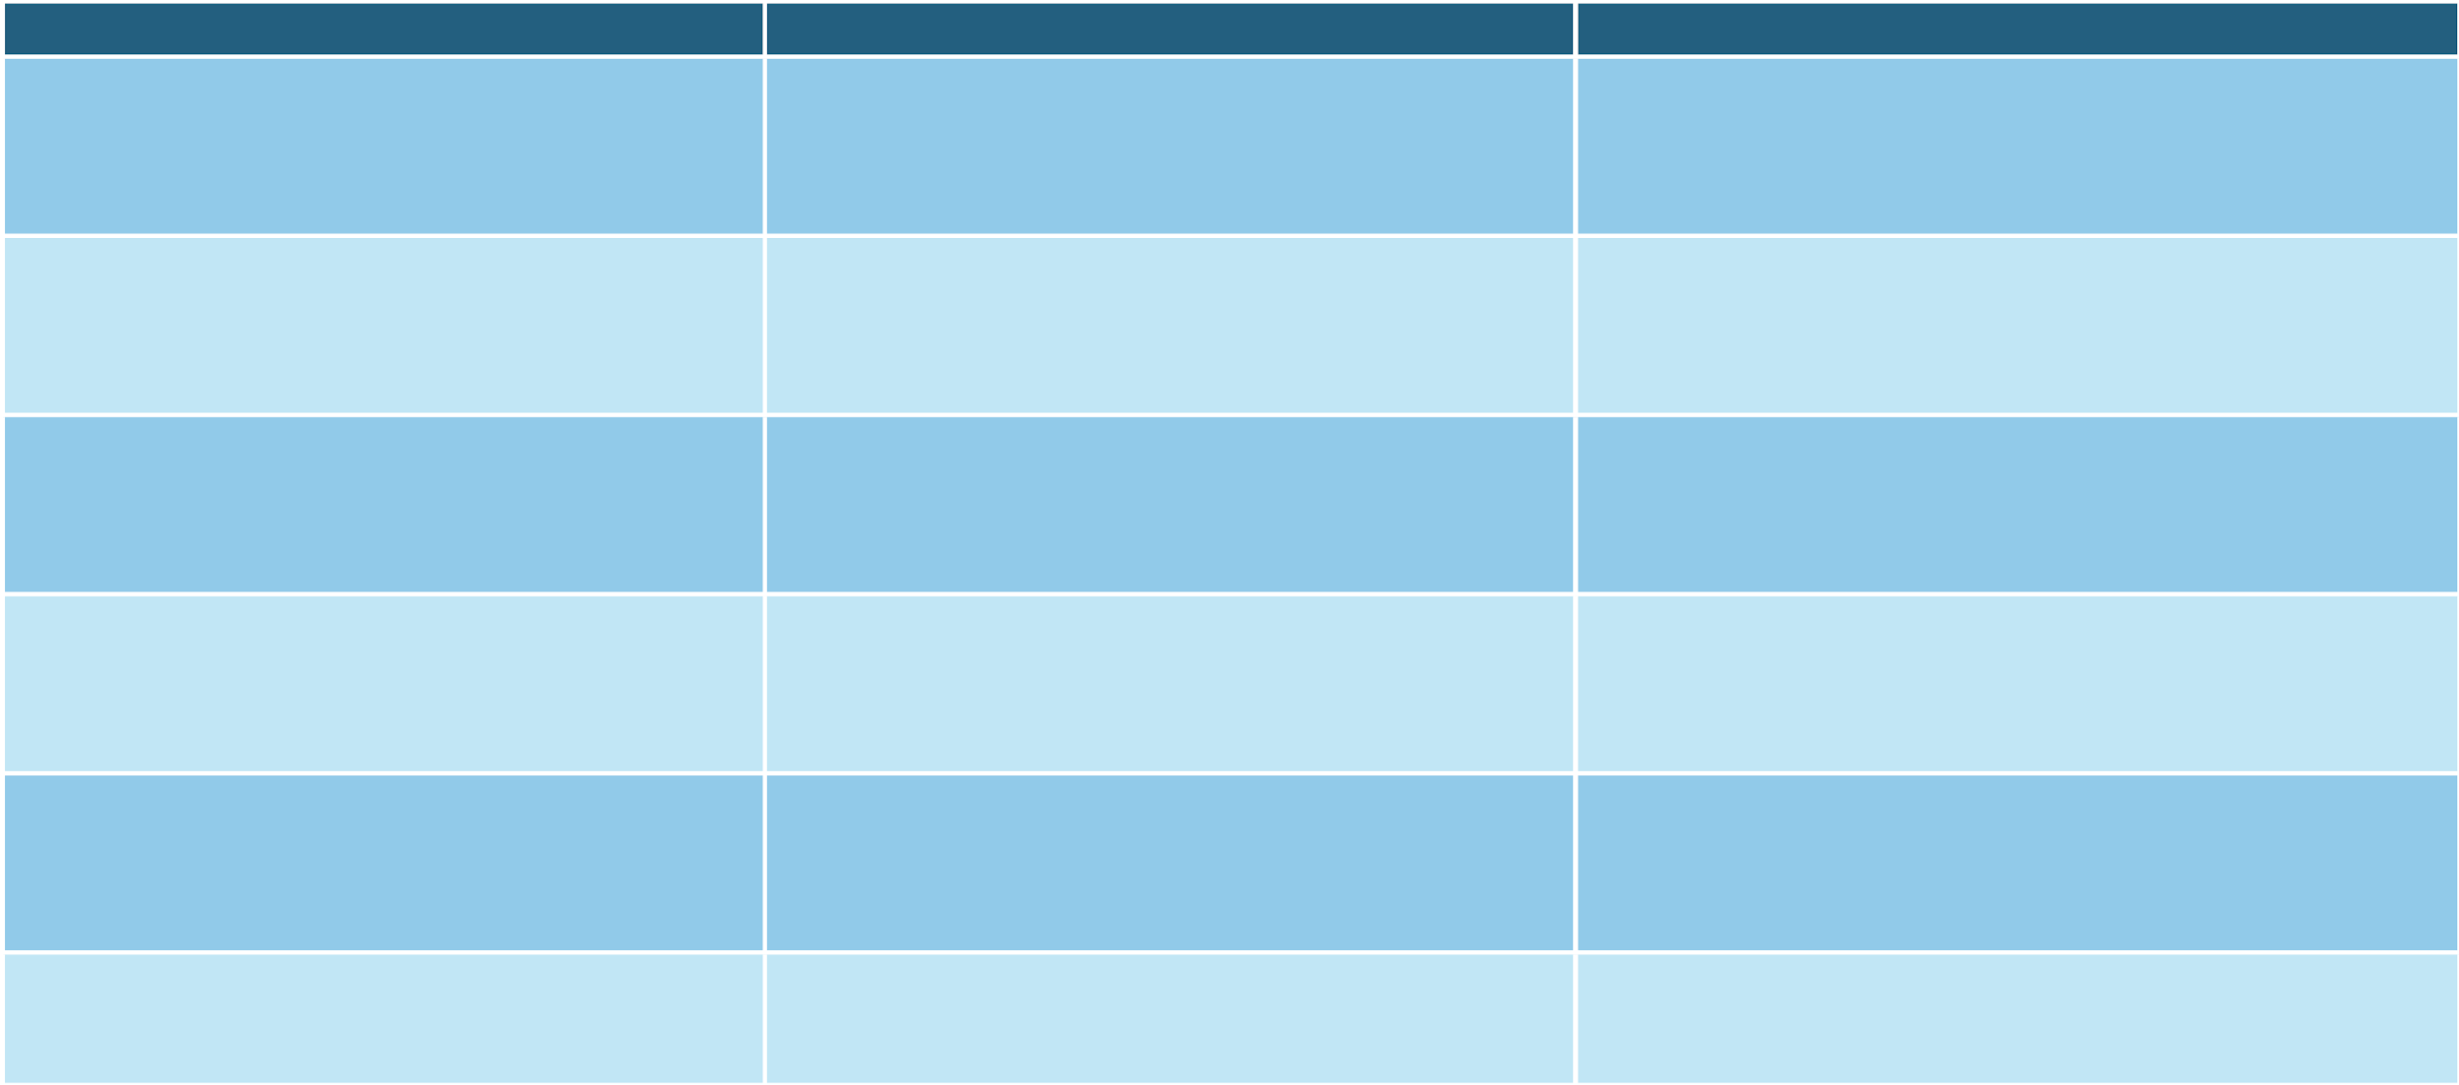


















SoC Memory Mapping
Region / Component
Address Range Details
Key Functionality
ROM Address Region
e.g., 0x00000000 - 0x00003FFF
Fixed base address; stores boot code and firmware. Accessible via standard load instructions.
SRAM Address Region
e.g., 0x10000000 - 0x100007FF (2KB)
Dedicated R/W range for data and runtime instructions. Supported via standard load/store.
UART Register Mapping
e.g., 0x40001000 - 0x4000100F
Memory-mapped for TX, RX, Status. CPU performs serial I/O via store/load operations.
Address Decoding Logic
Upper address bits used for decoding
AXI interconnect decodes address bits to route transactions to correct peripheral/memory slave.
CPU Interaction Model
Uniform access across all mapped regions
PicoRV32 uses standard RV32I load/store instructions for all mapped regions, simplifying software development.
Non-Overlapping Spaces
Unique, non-overlapping address ranges
Ensures correct data routing and prevents bus conflicts between different

Slide 21
Signal Reference — Top Module & CPU Ports
Top Module
Signal | Dir | Width | Description
clk | IN | 1-bit | System clock — drives CPU, bridge, UART
reset | IN | 1-bit | Active-high reset (CPU uses active-low internally)
uart_tx | OUT | 1-bit | Serial transmit output (connect to terminal)
uart_rx | IN | 1-bit | Serial receive input (not used here)
CPU Memory Bus (picorv32 ↔bridge)
Signal | Dir | Width | Description
cpu_mem_valid | OUT | 1-bit | CPU says memory request is active
cpu_mem_instr | OUT | 1-bit | 1 = instruction fetch, 0 = data access
cpu_mem_ready | IN | 1-bit | Bridge says request is complete
cpu_mem_addr | OUT | 32-bit | Address to access memory/peripheral
cpu_mem_wdata | OUT | 32-bit | Data to write
cpu_mem_wstrb | OUT | 4-bit | Byte enable (0 = read, non-zero = write)
cpu_mem_rdata | IN | 32-bit | Data received from memory

Slide 22
Signal Reference — Top Module & CPU Ports
AXI-Lite Master Signals (bridge → decoder/peripherals)
Signal Name | Direction | Width | Description
m_axi_awaddr | OUT | 32-bit | Write address channel: target address
m_axi_awvalid | OUT | 1-bit | Write address valid
m_axi_awready | IN | 1-bit | Slave ready to accept write address
m_axi_wdata | OUT | 32-bit | Write data channel: data to write
m_axi_wstrb | OUT | 4-bit | Write byte strobe (which bytes are valid)
m_axi_bvalid | IN | 1-bit | Write response valid (slave confirms write done)
m_axi_araddr | OUT | 32-bit | Read address channel: address to read from
m_axi_rdata | IN | 32-bit | Read data returned by the slave
m_axi_rvalid | IN | 1-bit | Read data is valid and can be captured

Slide 23
How the SoC Works Step by Step
1
Boot
5
Send via UART
CPU starts at address 0x0000_0000 (PROGADDR_RESET). Issues mem_valid with mem_addr=0. Bridge translates to AXI AR channel.
CPU writes a byte to address 0x1000_0000 via AXI W channel. UART AXI module receives it and starts uart_tx.
2
Fetch Instruction
6
UART Transmit
AXI decoder routes address to ROM. ROM returns 32-bit instruction. Bridge returns it to CPU as mem_rdata. CPU decodes it.
uart_tx.v shifts: START bit → 8 data bits (LSB first) → STOP bit at 115200 baud. Byte appears on uart_tx pin.
3
Execute
7
Repeat
CPU ALU executes instruction (add, load, store, branch). May need to read/write data memory (SRAM at 0x0001_0000).
CPU loops back to fetch next instruction. Stack in SRAM grows/shrinks as functions are called. Cycle continues.
4
SRAM Access
For data: bridge drives AXI W or AR to SRAM. SRAM returns/accepts data. Bridge signals mem_ready to CPU.

Slide 24
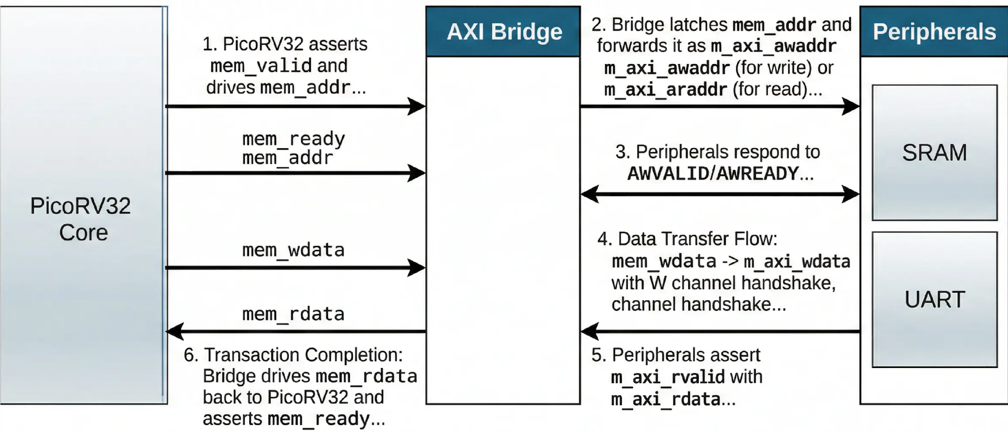
RTL Signal Flow

Slide 25




















Functional Simulation Flow
Comprehensive verification flow to confirm RTL correctness before synthesis in OpenLane.
Simulation Flow Stages
Stage / Component
Description / Activity
Key Outputs / Tools
Verilator Simulation
Compiles synthesizable Verilog RTL to a fast, cycle-accurate C++ model.
Compiled Executable, C++ Model
Testbench & Stimulus
Verilog and C++ Testbench drives top-level SoC, applies reset and peripheral transactions.
Verilog and C++ Testbench, System
Stimulus
Waveform Capture
Simulation outputs a Value Change Dump (VCD) file. Records all signal transitions.
FST, VCD Waveform File
Waveform Analysis
GTKWave loads VCD to display and visually analyze waveforms.
GTKWave Viewer
Verification Checklist
Key checks: CPU boot, memory responses, UART integrity, bus health.
Verification Report, Validation Results
OpenLane Integration
Passing simulation enables synthesis in OpenLane, reducing design iterations.
Confirmed RTL Code, Ready for Synthesis

Slide 26
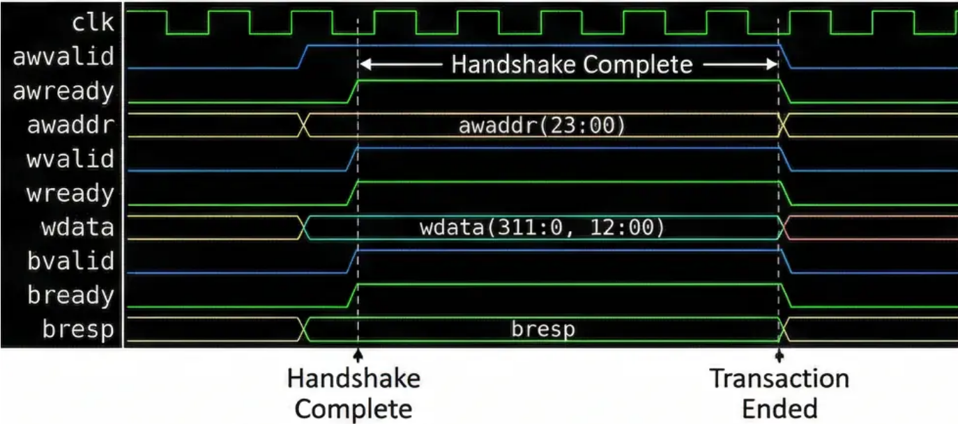
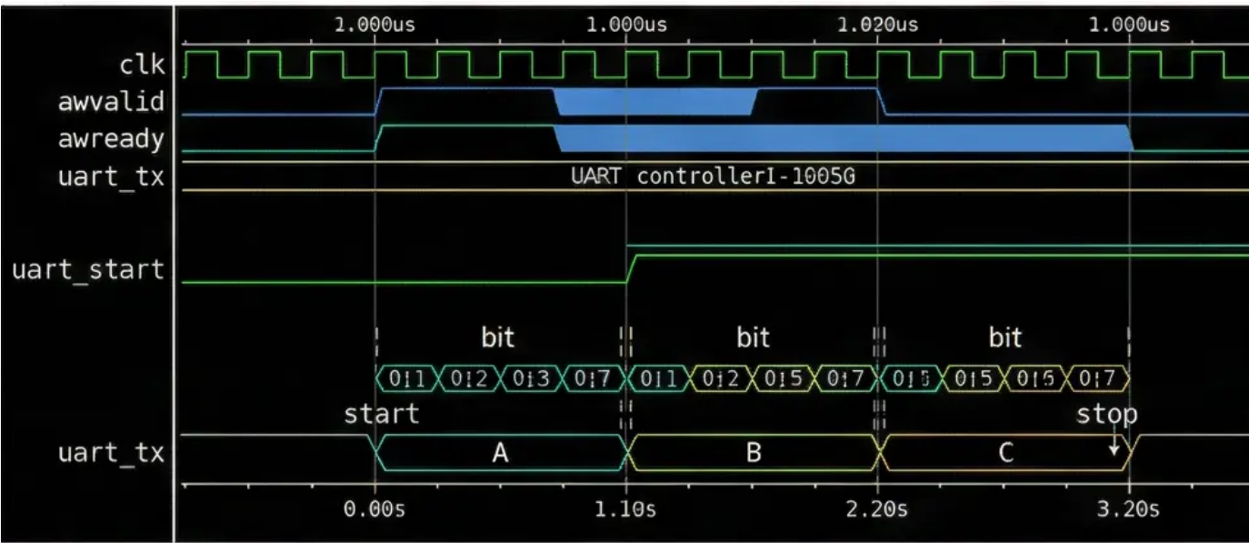
Verification and Waveforms
Verification Summary
Representative Waveforms
• AXI Write Handshake: Synchronous AWVALID/AWREADY & Timing diagrams confirm simultaneously-asserted signals complete write transactions within expected cycles.
• Signal Synchronization: Data transfer only occurs when VALID/READY are both high.
• Write Response Channel: Captured BVALID/BREADY handshake confirming slave write responses.
• UART Transmission Frame: Waveform analysis confirms start, 8 data, and stop bit sequences.
• Baud Rate & Frame Integrity: Simulation verifies bit timing matches the target baud rate with no errors.
• End-to-End Data Flow: Combined AXI & UART waveforms validate full CPU-to-AXI-to-UART data path.

Slide 27

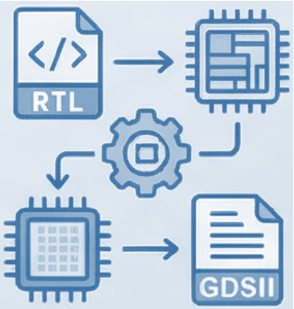






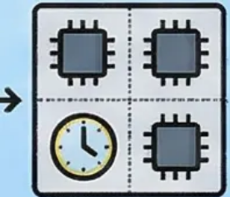
PART 2: PHYSICAL DESIGN IMPLEMENTATION
From RTL to GDSII
OpenLane Toolchain
SkyWater 130nm PDK
Transforming Verilog RTL code into a manufacturable physical layout using using the OpenLane automated flow.
An open-source EDA flow integrating synthesis, placement, routing, and verification into a unified pipeline.
Open-source process design kit providing technology rules and libraries for physical implementation.
Key Implementation Stages
Design Verification
Covers synthesis, floorplanning, placement, clock tree synthesis, routing, and final GDSII generation.
DRC and LVS checks ensure the physical layout is functionally correct and ready for fabrication.
DRC & LVS PASS

Slide 28
Physical Implementation Results
⚠ Note: Numbers below are illustrative design targets. Mark as TBD until full OpenLane2 run completes.
Timing
Area
Target Frequency
~50–100 MHz (TBD)
Total Cell Area
~0.08–0.15 mm² (TBD)
Critical Path
SRAM read + interconnect mux
Core Utilization
~40–60% (target)
Setup Slack
> 0 ns (target)
Standard Cells
~15,000–25,000 (TBD)
Hold Slack
> 0 ns (target)
Die Size
TBD after floorplan
DRC/LVS
PPA
DRC Violations
0 (target — clean)
Power (typical)
~5–20 mW (TBD)
LVS Status
Pass (target)
Technology
SkyWater 130nm (SKY130B)
Antenna Violations
0 (after diodes)
Metal Layers
6 layers utilized
ERC Errors
0 (target)
Clock Tree
H-tree (auto CTS)

Slide 29

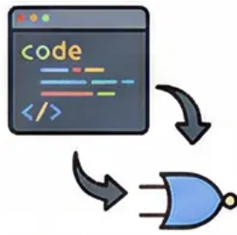
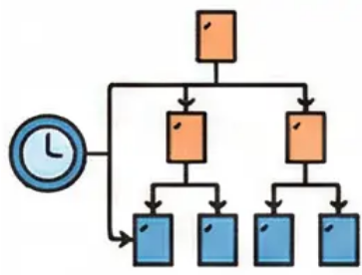
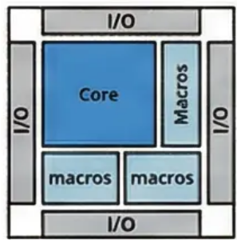


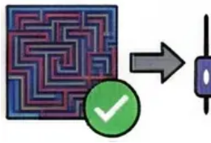

RTL to GDSII Flow Overview
Synthesis: RTL to Gate-Level Netlist
Clock Tree Synthesis (CTS)
1
Yosys translates Verilog RTL into a gate-level netlist. Utilizes SkyWater 130nm standard cell libraries.
4
Builds a balanced clock distribution network to minimize skew across all sequential elements.
Floorplanning: Chip Area Definition
Routing: Physical Interconnect
2
Defines die size, core area, I/O pad placement, and macro block positions for the SoC layout.
5
TritonRoute connects all placed cells using metal layers, following PDK design rules.
Placement: Standard Cell Positioning
Signoff: DRC, LVS, and GDSII Export
3
OpenROAD places synthesized standard cells onto the floorplan, optimizing for timing and density.
6
Magic and Netgen perform Design Rule Check and Layout vs. Schematic verification before final GDSII generation.

Slide 30














Physical Design Toolchain — Toolchain Overview
Tool
Primary Role
Key Function & Details
Yosys
RTL Synthesis
Converts Verilog RTL into a gate-level netlist; performs logic optimization and technology mapping to the SkyWater 130nm library.
OpenROAD
Place and Route (PnR)
Automates floorplanning, standard cell placement, clock tree synthesis (CTS), and detailed routing to produce a complete physical layout.
Magic
DRC & Layout Viewer
Performs Design Rule Checking (DRC) to verify physical layout complies with SkyWater 130nm fabrication constraints.
OpenLane
Unified Flow Orchestrator
Integrates Yosys, OpenROAD, and Magic into a single automated RTL-to-GDSII pipeline, controlled via a configuration file.
SkyWater 130nm PDK
Technology Integration
Open-source Process Design Kit providing technology libraries, design rules, and SPICE models referenced by all design tools.
Netgen
LVS Verification
Performs Layout Versus Schematic (LVS) checks to confirm layout netlist is electrically equivalent to the original gate-level netlist.

Slide 31

Synthesis and Floorplanning
Synthesis Process Flow
Floorplanning & PDN Setup
RTL to Gate-Level Netlist: Transformation of RTL Verilog into a netlist using Yosys as part of the OpenLane flow.
Die Area Definition: Establishing the die boundary to 1000um x 1000um.
1
1
Standard Cell Mapping: Mapping the netlist gates to the SkyWater 130nm process library.
SRAM Macro Placement: Strategic placement of the 2KB SRAM hard macro near core data-path logic.
2
2
Logic & Area Optimization: Gate-level optimization for reduced die area and logic depth.
I/O Pad & Pin Assignment: Pad and VSS rings for initial power delivery.
3
3
Timing Analysis & Constraint Checking: SDC (Synopsys Design Constraints) analysis for initial timing.
4
PDN Ring Construction: VDD and VSS rings for initial power delivery.
Post-Synthesis Netlist Verification: Functional and area verification of the generated netlist.
VDD & VSS Strap Construction: PDN straps on upper metal layers for power distribution.
5
5
Logic Area Estimation & Power Analysis: Estimation of final core area and initial power consumption.
Standard Cell Power Grid Distribution: Power grid from straps to individual standard cells.
6
6
PDN CONSTRUCTION CONCEPTUAL FLOW → VDD Ring → VDD Strap → Power Rail → Standard Cells Synthesis to PDN Construction Conceptual Flow

Slide 32

Placement and Clock Tree Synthesis
STANDARD CELL PLACEMENT
CLOCK TREE SYNTHESIS (CTS)
GATE-LEVEL NETLIST PLACEMENT: Place cells from netlist onto chip floorplan.
CLOCK DISTRIBUTION: Create balanced buffer tree for uniform signal distribution.
1
1
PDK CONSTRAINTS: Optimize within SkyWater 130nm PDK rules (Area/Timing/Routability).
SKEW MINIMIZATION: Minimizing skew between all sequential elements.
2
2
WIRE LENGTH MINIMIZATION: Place cells to reduce total interconnect length.
TOPOLOGIES: Utilize balanced H-tree or mesh structures.
3
3
CONGESTION MANAGEMENT: Ensure cells are distributed for efficient routing.
LATENCY EQUALIZATION: Controlling clock latency to prevent setup/hold violations.
4
4
CRITICAL PATH FOCUS: Optimize timing for PicoRV32 core logic paths.
POST-CTS STA: Static Timing Analysis verifies all constraints met.
5
5
AXI4-LITE INTERCONNECT: Optimize logic for AXI4-Lite subsystem interface.
TIMING CLOSURE: Confirm SoC subsystems operate correctly at target frequency.
6
6
PHYSICAL DESIGN FLOW: FLOORPLANNING → PLACEMENT (Optimization) → CTS (Clock Distribution) → TIMING VERIFICATION (STA)

Slide 33






Routing and Signoff Verification
Detailed Routing & Physical Checks
Verification & Signoff Closure
1
4
Detailed Routing with OpenLane
Layout vs. Schematic (LVS)
OpenLane automates detailed routing, connecting all placed standard cells using metal layers defined by the SkyWater 130nm PDK design rules.
LVS compares the extracted layout netlist against the original gate-level schematic to confirm both representations are electrically equivalent.
2
Design Rule Check (DRC)
5
GDSII File Generation
DRC verifies that the physical layout strictly conforms to the foundry's manufacturing constraints, ensuring no spacing or width violations exist.
After all signoff checks pass, OpenLane produces the final GDSII layout file, which is submitted to the SkyWater 130nm foundry for fabrication.
3
6
Antenna Rule Violation Fixes
Signoff Closure Confirmation
During routing, long metal wires can accumulate charge and damage gates; antenna checks detect and resolve these violations before tape-out.
Successful DRC and LVS signoff closure confirms the SoC subsystem layout is fully manufacturable and ready for physical production.

Slide 34
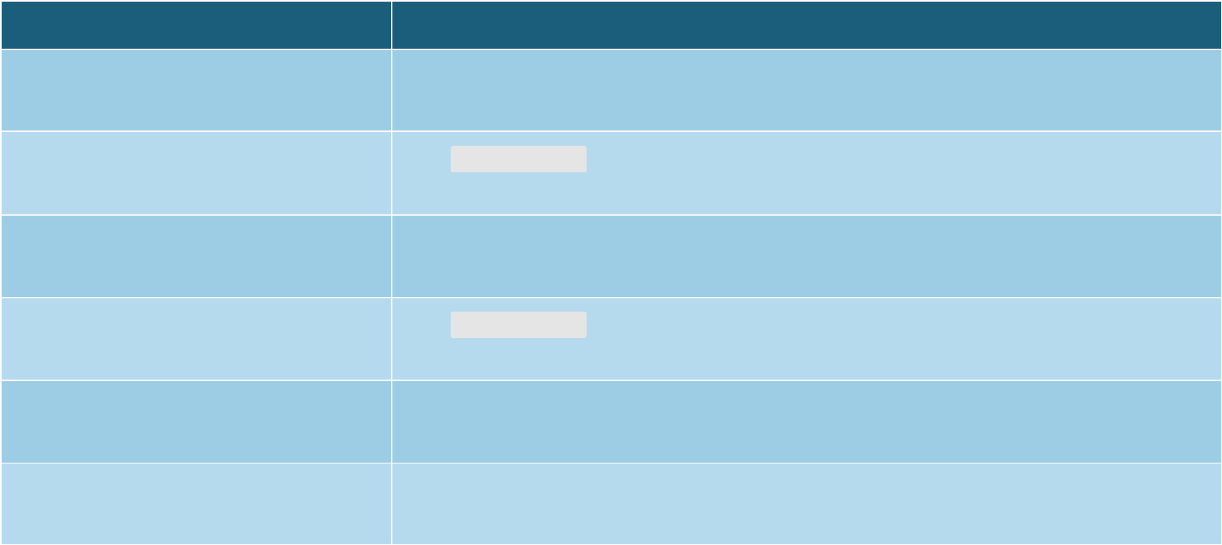










OpenLane Configuration
Configuration Setting
Description
PDK Selection: SkyWater 130nm
The SKY130 open-source PDK provides technology libraries, design rules, and models required for manufacturable physical layout generation.
Clock Period Constraint
The defines the target clock period, setting timing constraints that guide synthesis and placement for timing closure.
Core Utilization Target
Core utilization is configured to balance cell density and routing congestion, typically set between 40-60% for reliable implementation.
Die Area and Floorplan Settings
The specifies die dimensions and core margins, defining the physical boundary for standard cell placement and routing.
Design Top Module Declaration
The top-level Verilog module name and source file paths are declared, directing OpenLane to the correct RTL entry point for synthesis.
Synthesis and Routing Strategies
Parameters such as routing layer assignments and synthesis strategy flags are tuned to optimize area, power, and timing for the SoC subsystem.

Slide 35

Physical Implementation Results
The physical implementation flow from RTL to GDSII was successfully executed using the OpenLane toolchain and SkyWater 130nm PDK, achieving timing closure and a clean manufacturable design.
Technology & Toolchain
Area Utilization
Timing Analysis
Implemented using the open- source SkyWater 130nm process design kit (PDK) via the OpenLane RTL-to-GDSII flow.
Calculated standard cell area and total core utilization percentage after placement and routing stages (e.g., 0.12mm² at 78% util).
Worst Negative Slack (WNS) and Total Negative Slack (TNS) verify timing closure with no critical path violations (e.g., WNS: 0.15ns, TNS: 0ns).
Clock Frequency
Verification: DRC & LVS
Final GDSII Output
The PicoRV32-based SoC subsystem meets the target clock frequency after Clock Tree Synthesis (CTS) and routing optimization (e.g., 100 MHz).
Successfully passed Design Rule Check (DRC) and Layout vs. Schematic (LVS) verification, confirming a clean, manufacturable layout with zero violations.
Final GDSII file successfully generated by OpenLane, representing the complete physical layout ready for foundry submission.

Slide 36
Sub-module 8 — Complete Lab Command Reference
make fw
Build
make soc
Simulate
Compile fw/main.c → rom.hex (firmware binary)
Full SoC sim: 9 RTL + tb_top.v → TEST PASSED
make wave
Debug
make debug_soc
Debug
vcd2fst compress + open GTKWave (tb_top.fst)
Verbose tb_debug.v — extra signal logging
make synth
Synth
make openlane
ASIC
Yosys synthesis: -D SYNTHESIS → top.json
Full OpenLane2 flow → GDSII (SkyWater 130nm)
make pico
Sub-module 1
make axi_sa
Sub-module 2
PicoRV32 core standalone test
AXI-Lite handshake standalone test
make uart
Sub-module 3
make soc_pico_uart_mem
Sub-module 4
UART TX/RX loopback test
MMI SoC: PicoRV32 + UART + memory
make riscv_axi
Sub-module 5
make axi_uart
Sub-module 6
RISC-V to AXI bridge demo
AXI UART peripheral standalone

Slide 37
OpenLane & Synthesis Configuration
# Synthesis: make synth
OpenLane Physical Design Flow
yosys -D SYNTHESIS \
Synthesis
Yosys: RTL → gate-level netlist
-p 'synth_design -top top' \
rtl/picorv32.v rtl/top.v \
rtl/axi_lite_interconnect.v \
Floorplan
Die area, core area, I/O placement
rtl/axi_decoder.v \
rtl/rom.v rtl/sram.v \
Placement
Standard cell placement (RePlAce)
rtl/uart_axi.v \
rtl/uart_tx.v rtl/uart_rx.v
CTS
Clock Tree Synthesis — H-tree
# Outputs:
→ top.json (JSON netlist)
Routing
Global + detailed (OpenROAD)
→ synth.v (Verilog netlist)
DRC / LVS
Magic + Netgen checks
# ASIC-clean constraints:
-D SYNTHESIS activates:
• case-stmt ROM (not readmemh)
GDSII Export
KLayout → GDSII stream out
• no initial blocks anywhere
• no inline reg initializers
Technology: SkyWater 130nm PDK | Config: openlane_design/config.json | Command: make openlane

Slide 38





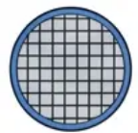
Applications of the SoC
This RISC-V SoC subsystem offers a flexible and efficient platform across various embedded application domains, from industrial control to academic research.
IoT Edge Devices
Educational VLSI Platform
Low power, small footprint, for sensor data processing
Hands-on learning platform using OpenLane & SkyWater PDK
Wireless Sensor Nodes
Custom Accelerator Prototyping
Efficient environmental data collection with UART and SRAM
Domain-specific accelerator prototyping with modular ISA
Industrial Embedded Controllers
Low-Cost Silicon Research
Reliable real-time control in lightweight automation
Affordable academic tape-outs with royalty-free design

Slide 39
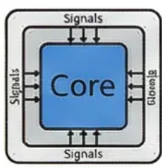
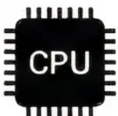

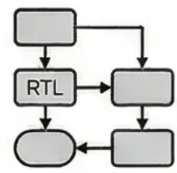
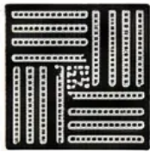

Conclusion
This project successfully demonstrates a low-cost, all-open-source design-to-silicon flow for a RISC-V SoC subsystem, from RTL implementation to physical design.
Core Integration
AXI4-Lite Interconnect
Peripheral Design
PicoRV32 RV32IMC core was implemented with an AXI4-Lite master interface, enabling seamless communication across the SoC subsystem.
The five-channel AXI4-Lite fabric with VALID/READY handshake was functionally verified, ensuring reliable data transfer between the master and slave peripherals.
2KB SRAM and UART modules were successfully designed in RTL and verified, supporting data storage and serial communication for embedded applications.
RTL-to-GDSII Flow
Manufacturability GDSII
Ecosystem Validation
OpenLane automated the full physical design flow including synthesis, placement, routing, and DRC/LVS checks using the SkyWater 130nm PDK.
The final GDSII output was produced, demonstrating a complete and low-cost path from RTL design to a foundry-ready physical layout.
The project confirms that open- source tools including RISC-V, OpenLane, and SkyWater PDK provide a viable, accessible platform for custom SoC development.

